Slide 1
A
PROJECT REPORT
ON
CODEWORK FREELANCER MANAGEMENT SYSTEM
Submitted to:
Shri C.J. Patel Collage of Computer Studies, Visnagar
Affiliated to:
Sankalchand Patel University
Submitted by:
STUDENT NAME ROLL NO. EXAM NO.
Vivek Patel 22
Priya Patel 17
Gaurang Parmar 09

Slide 2
PROJECT PROFILE
PROJECT NAME | CODEWORK FREELANCER MANAGEMENT SYSTEM
OBJECTIVE | We provide information about freelancers and freelancing services
FRONT END TOOL | PHP 5.6.31
BACK END TOOL | MySQL 5.0.11
SYSTEM SOFTWARE | Windows 10
DOCUMENTATION | MS Office 2016
OTHER TOOL | Dreamweaver CC
DEVELOPED BY | Vivek D. Patel Priya S. Patel Gaurang J. Parmar

Slide 3
DRAWBACK OF EXISTING SYSTEM
The current system its total manual.
In existing system, client has physically to visit our office to satisfy his/her requirement – according to client requirement; project has been given to the developers.
It becomes difficult to maintain records of clients and developers on paper.

Slide 4
NEED FOR NEW SYSTEM
Various freelancer can be found for different type of website development and designing work.
Client can post project and choose a best freelancer from all of list.
Browse freelancer profiles, compare proposals and select the best one, award your project and your freelancer goes to work.
Pay when you are satisfied!
Codework has no access fees, subscriptions, monthly fees or annual fees. There are no fees to post a project or set up a user account. Employer commissions and upgrade fees are also waived for volume customers.

Slide 5
HARDWARE TOOLS
PROCESSOR : Intel Core i3
RAM : 4GB
HARD-DISK : 500GB
WINDOWS : WINDOWS 10

Slide 6
SOFTWARE TOOLS
FRONT END TOOL : PHP 5.6.0
BACK END TOOL : MySQL 5.0
OTHER TOOLS : MS Word 2016
MS PowerPoint 2016

Slide 7
SYSTEM DESIGN DATA FLOW DIAGRAM

Slide 8
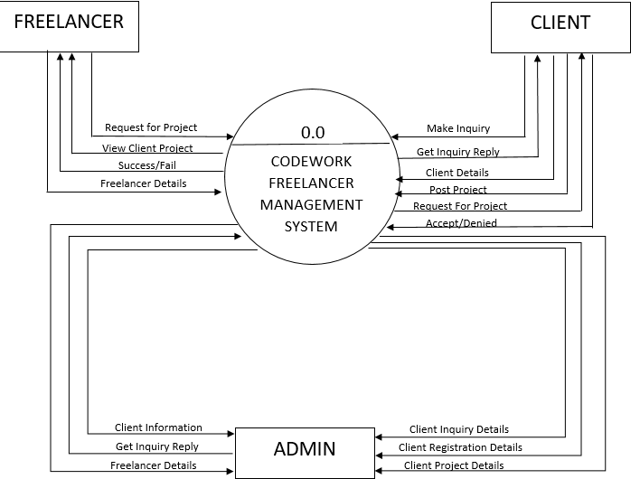
CONTEX LEVEL DIAGRAM

Slide 9
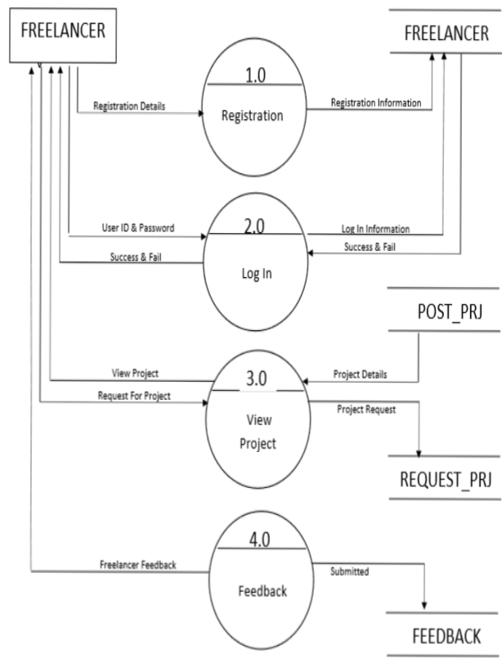
FIRST LEVEL DIAGRAM FREELANCER

Slide 10
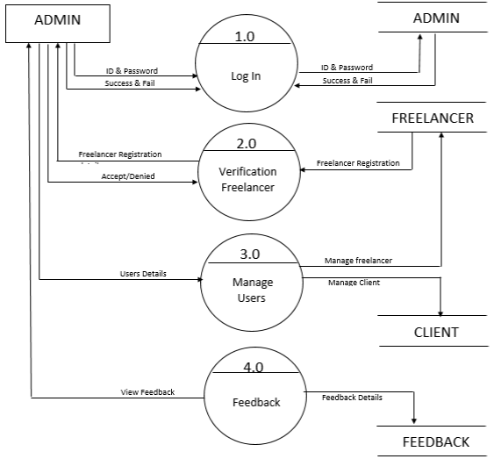
FIRST LEVEL DIAGRAM ADMIN

Slide 11
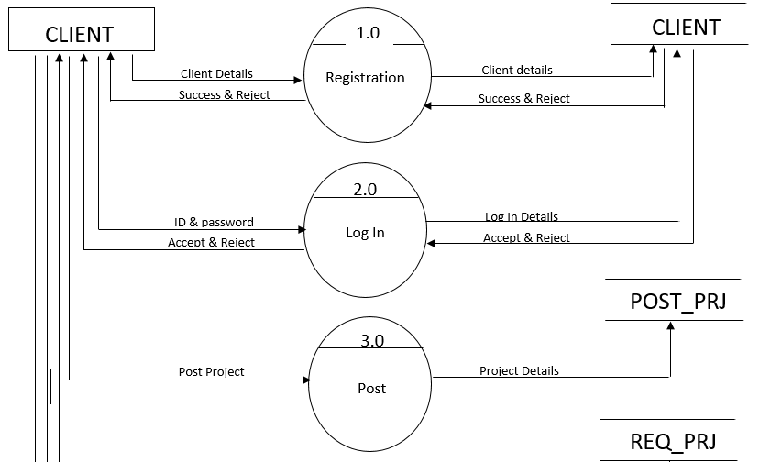
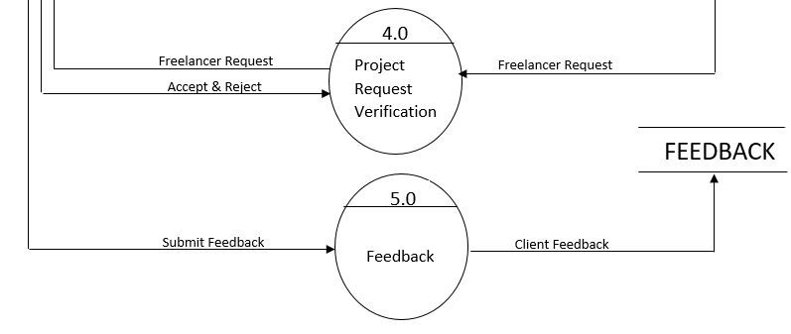
FIRST LEVEL DIAGRAM CLIENT

Slide 12
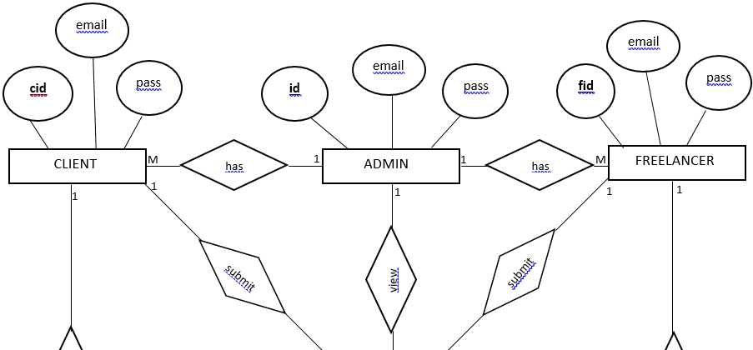
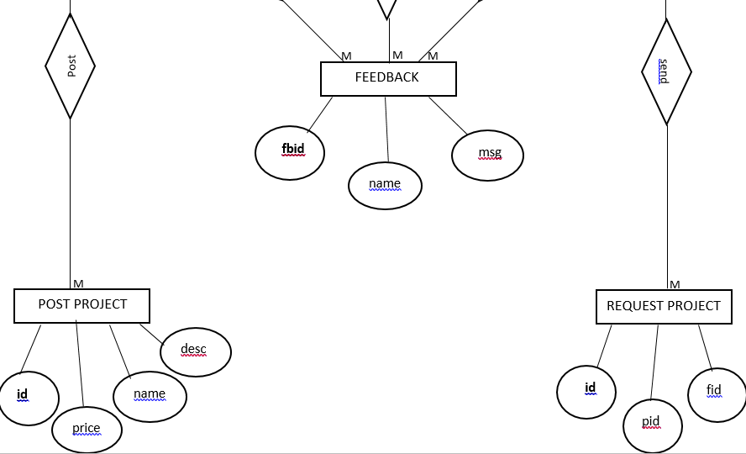
E R DIAGRAM

Slide 13
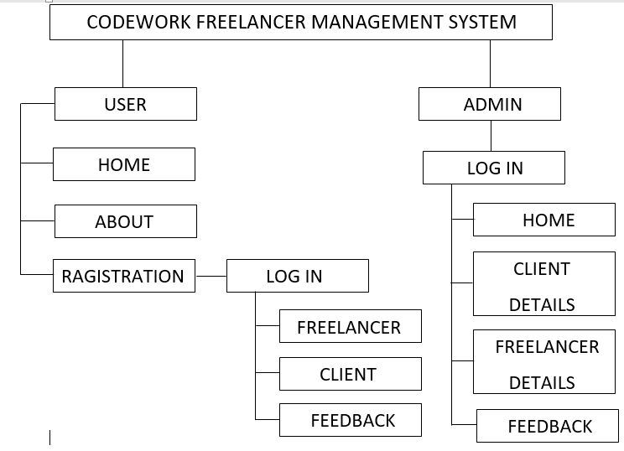
H R DIAGRAM

Slide 14
DATA DICTIONARY
1.Admin
Sr.No | Field Name | Type | Size | Constraints | Description
1 | Id | Int | 11 | Primary key | Admin id
2 | Name | Varchar | 30 | Not null | Admin name
3 | Email | Varchar | 30 | Unique key | Admin email
4 | password | Varchar | 128 | Not null | Admin password
5 | date | Time stamp | - | Current timestamp | Date Update Records
Description: - Admin login information.

Slide 15
2. Client
Sr.No | Field Name | Type | Size | Constraints | Description
1 | cid | Int | 11 | Primary key | client id
2 | Name | Varchar | 30 | Not null | client name
3 | Email | Varchar | 30 | Unique key | client email
4 | password | Varchar | 128 | Not null | client password
5 | date | Time stamp | - | Current timestamp | Client sign up Date
Description: - Client registration details.

Slide 16
3. Feedback
Sr.No | Field Name | Type | Size | Constraints | Description
1 | Fbid | int | 11 | Primary key | Feedback id
2 | Name | Varchar | 30 | Not null | user name
3 | Email | Varchar | 50 | Unique key | user email
4 | Msg | Varchar | 255 | Not null | Feedback message
5 | Is_read | Tinyint | 1 | Not null | Msg read or not
6 | date | Time stamp | - | Current timestamp | Feedback Date
Description: - user feedback details.

Slide 17
4. Freelancer
Sr.No | Field Name | Type | Size | Constraints | Description
1 | Fid | Int | 11 | Primary key | freelancer id
2 | Name | Varchar | 30 | Not null | freelance name
3 | Email | Varchar | 50 | Unique key | freelance email
4 | password | Varchar | 32 | Not null | freelancer password
5 | lang | Varchar | 10 | Not null | Programming language
6 | Cv | Varchar | 50 | Not null | Path of resume file
7 | Id_proof | Varchar | 50 | Not null | Path of Id/proof file
8 | date | Time stamp | - | Current timestamp | Freelancer Sign up Date
Description: - freelancer registration details.

Slide 18
4. post_prj
Sr.No | Field Name | Type | Size | Constraints | Description
1 | Pid | Int | 11 | Primary key | Project id
2 | Name | Varchar | 30 | Not null | Project name
3 | Detail | Text | - | Not null | Project detail
4 | catagory | Varchar | 30 | Not null | Project catagory
5 | File | varchar | 255 | Not null | Browse project file
4 | Lang | Varchar | 20 | Not null | programming language
5 | cid | Int | 11 | Not null | Client id
6 | Fid | Int | 11 | Not null | Freelancer id
7 | Status | Varchar | 20 | Not null | Project status
8 | Cost | Int | 11 | Not null | Project cost
9 | Paid | int | 11 | Not null | Project paid
10 | Date | Time stamp | - | Current timestamp | Project Date
Description: - client post project details.

Slide 19
4. post_req
Sr.No | Field Name | Type | Size | Constraints | Description
1 | Rid | Int | 11 | Primary key | Request id
2 | Pid | Int | 11 | Not null | Project id
3 | Fid | Int | 11 | Not null | Freelancer id
4 | Msg | Varchar | 255 | Not null | Message
5 | Status | Varchar | 20 | Not null | Project status
6 | Date | Time stamp | - | Current timestamp | Project Request date
Description: - freelancer project request details.

Slide 20

1. Home Page
Description:-This is the Home Page.

Slide 21
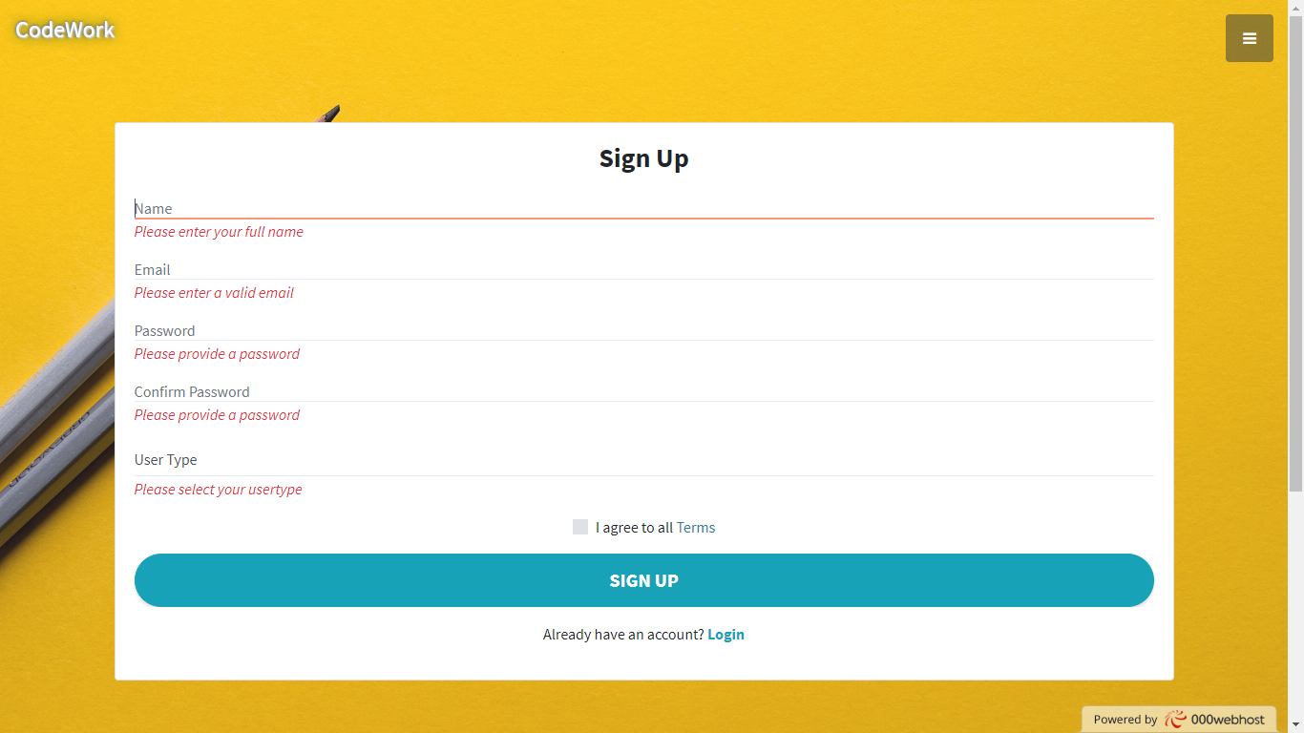
2. Registration Page
Description:-This is the registration page.

Slide 22
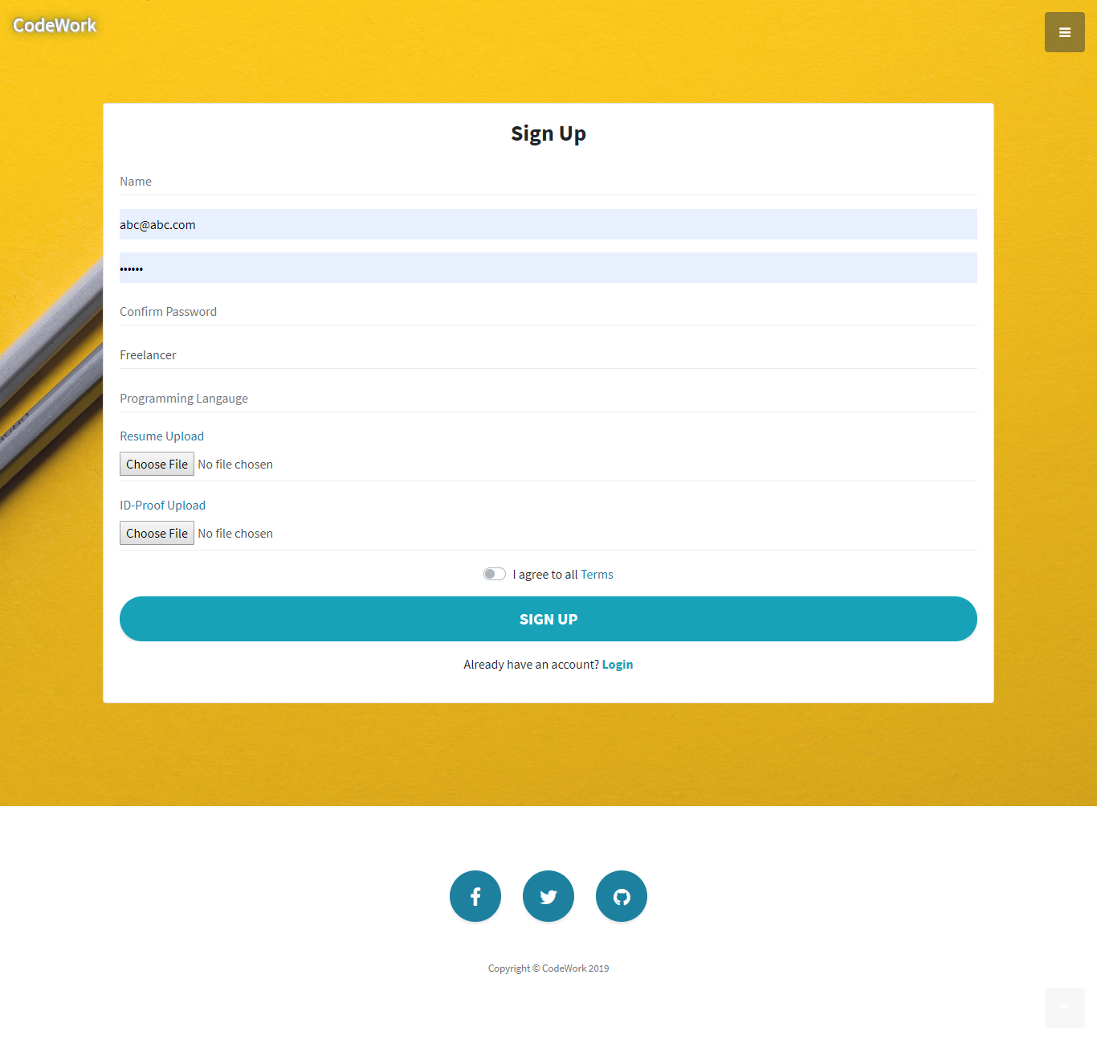
3. Freelancer Registration Page
Description:-This is the freelancer registration page.

Slide 23
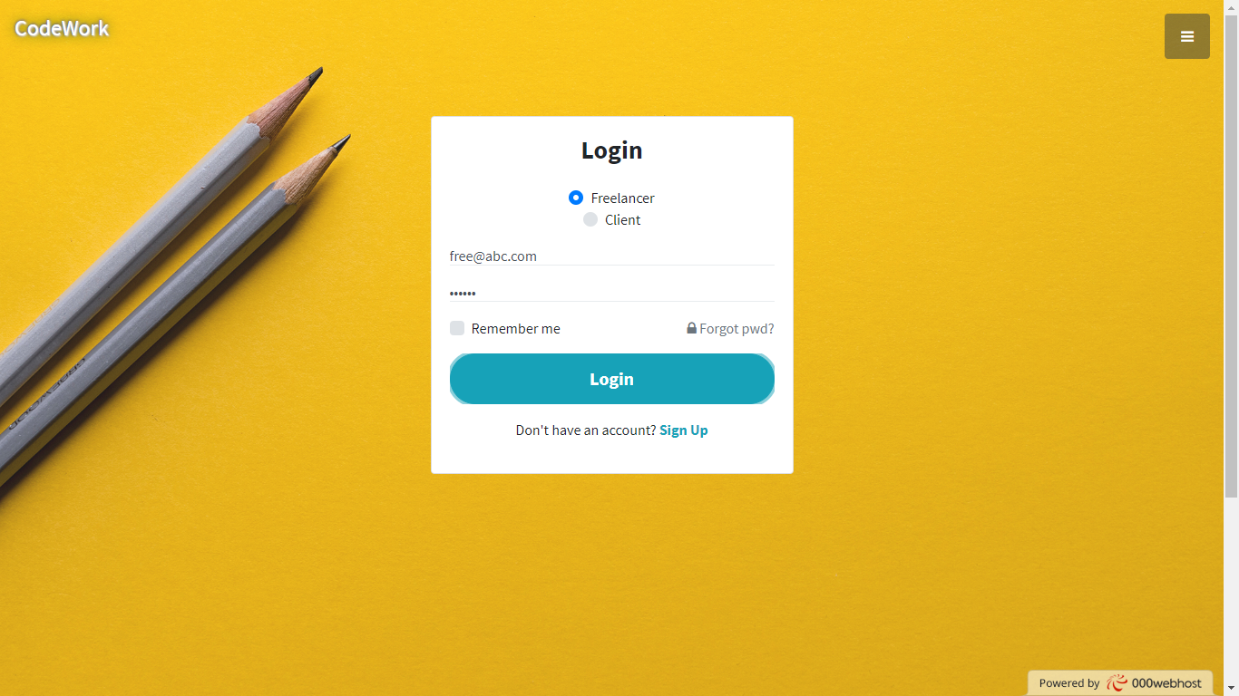
4. Login page
Description:-This is Login page for freelancer and client both.

Slide 24

5. Admin Login page
Description:-This is admin Login page.

Slide 25
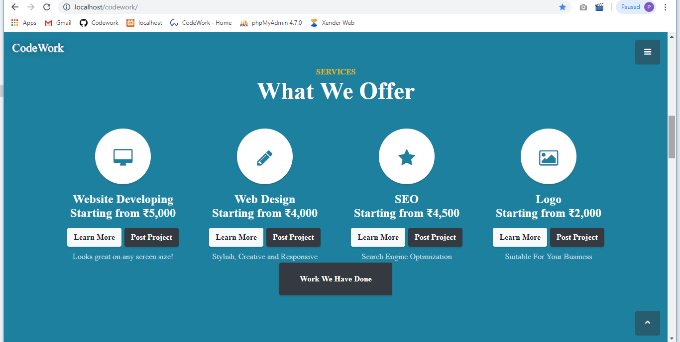
6. Services
Description:-This is the available services.

Slide 26
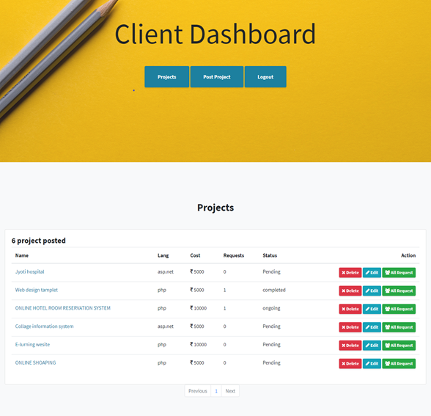
7. Client View
Description:-This is editable page for client’s post.

Slide 27
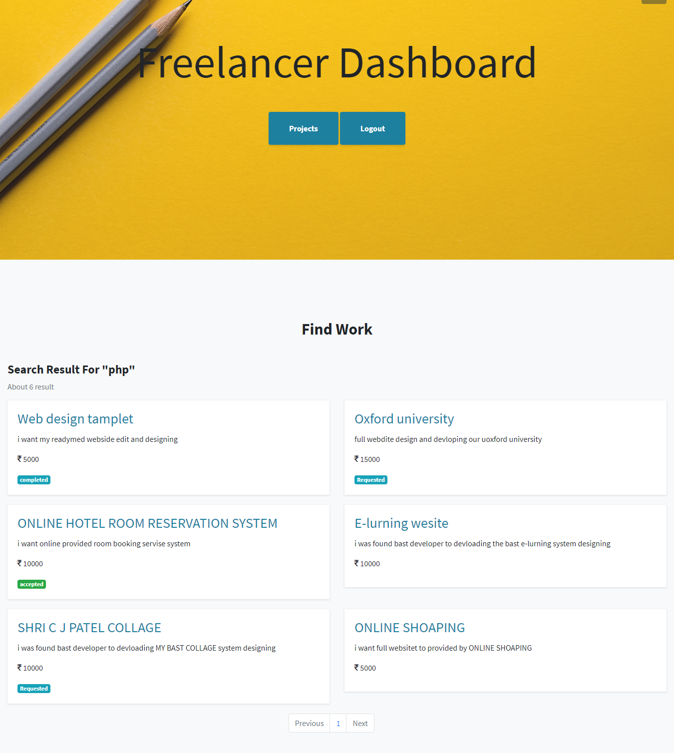
8. Freelancer view
Description:-This is the dashboard of freelancer.

Slide 28
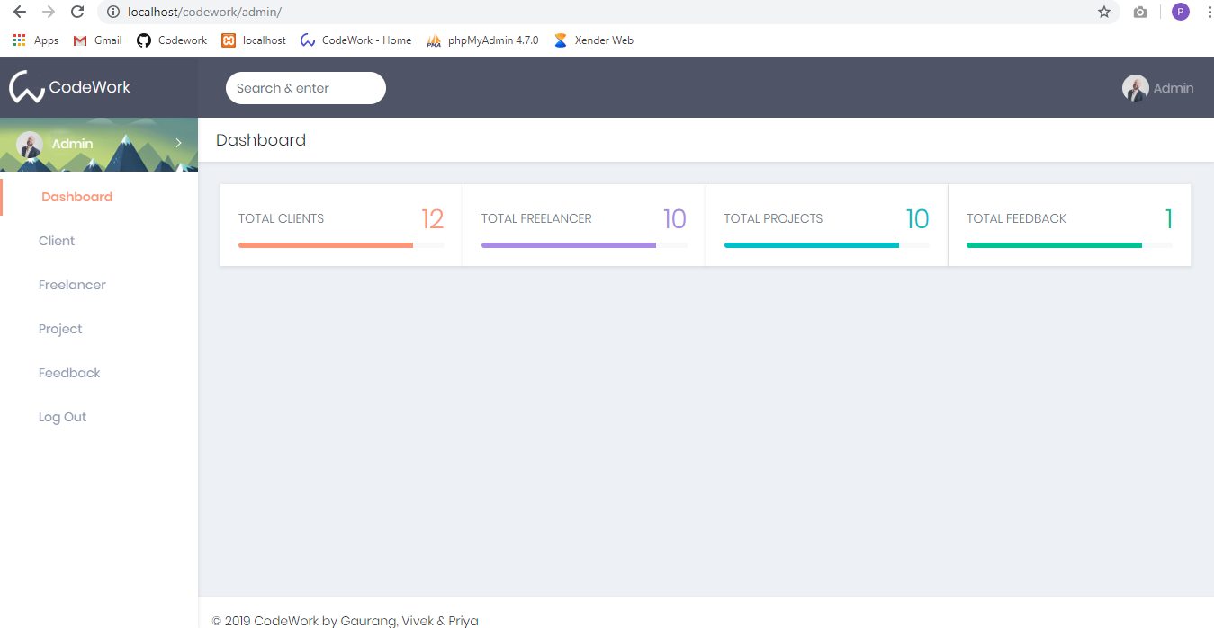
REPORT DESIGN
1. Admin Home Page
Description:-This is login page admin side.

Slide 29
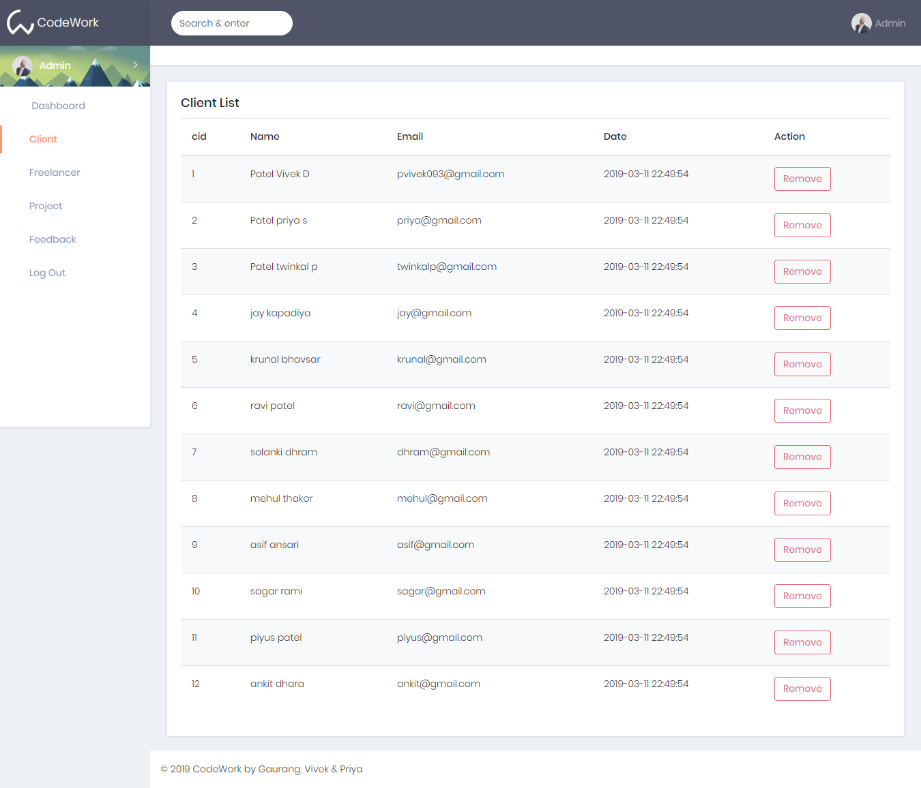
2. Client Report
Description:-This is client report.

Slide 30
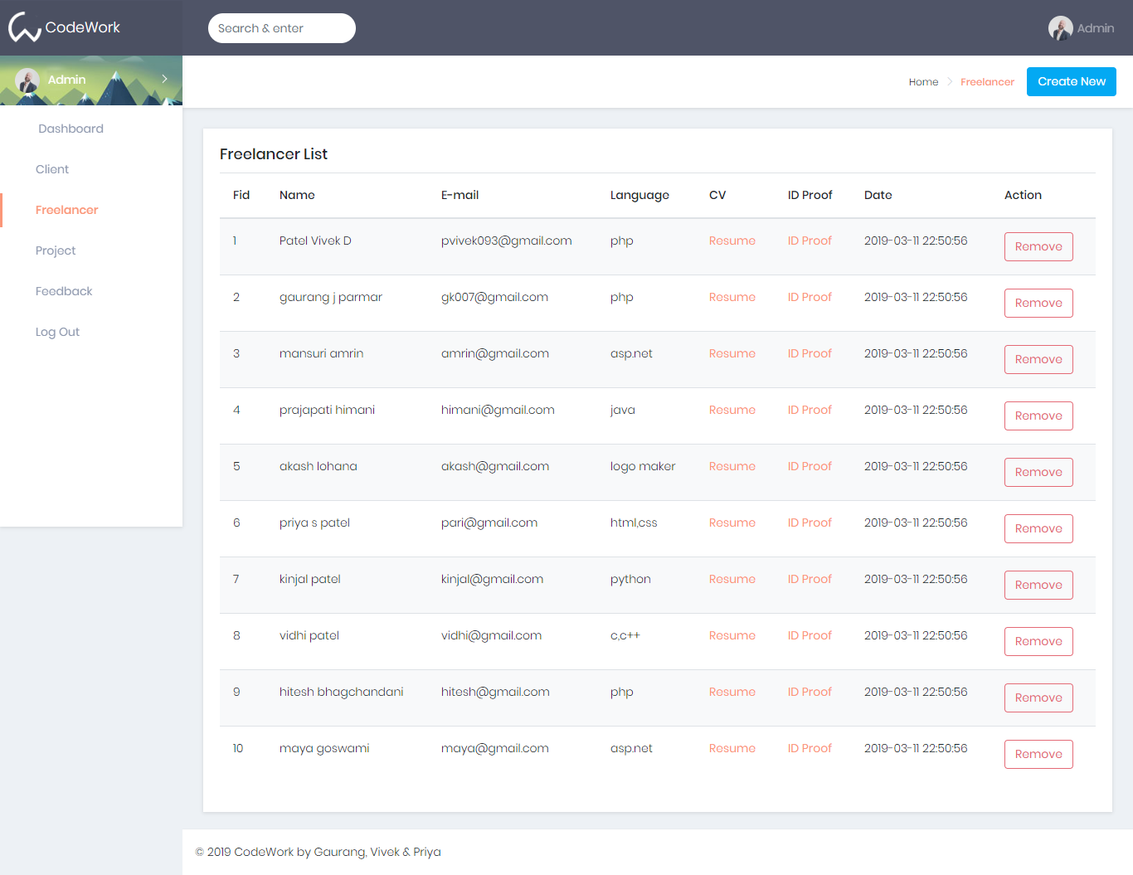
3. Freelancer Report
Description:- This is freelancer report.

Slide 31
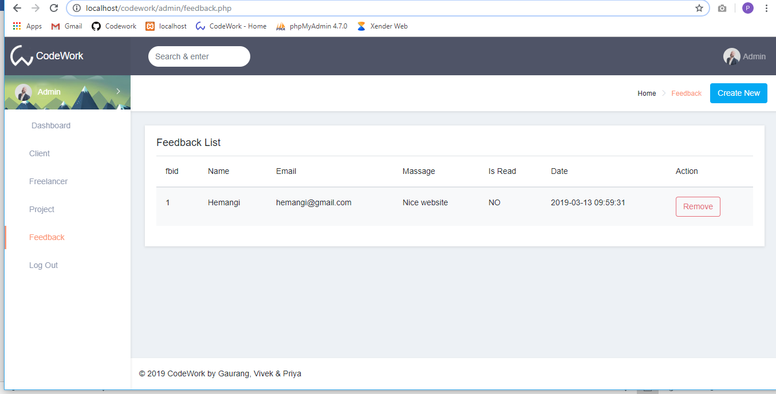
4. Feedback Report
Description:- This page is after login admin side provide information about feedback report.

Slide 32
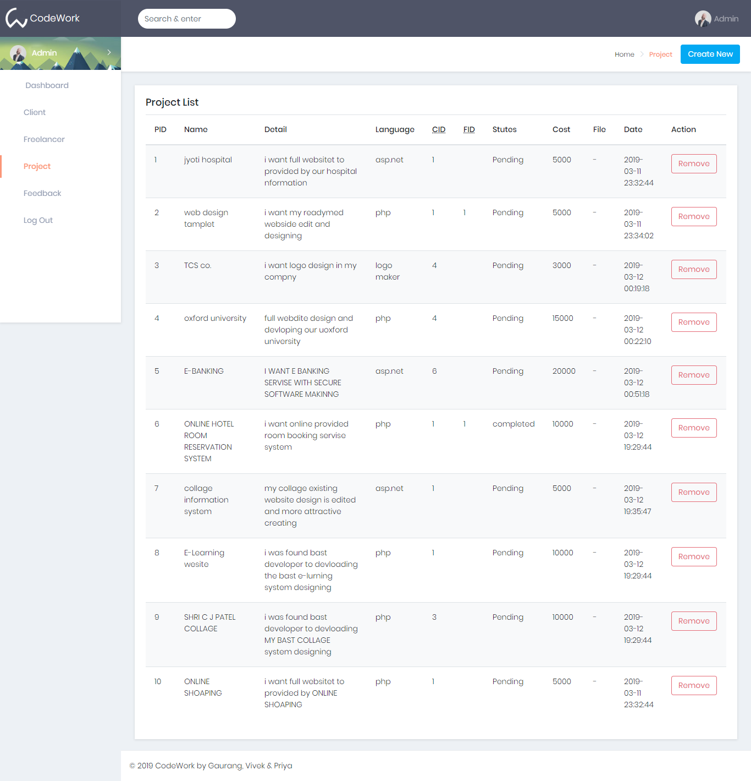
5. Project Report
Description:- This page is after login admin side provide information about project report.

Slide 33



BIBILIOGRAPHY
https://www.w3school.com/php5
https://getbootstrap.com/docs/4.0/getting-started/introduction
https://github.com/gaurangkumar/codework.git

Slide 34
THANK YOU…

